Slide 1
Intellectual Property
Week 5
Book: Ethics for Information Age (Chapter 4), A Gift of Fire (Chapter 04)
Maham Noor
Lecturer
University of Central Punjab

Slide 2
Weightage
Reminder
Assessments | Quizzes (15%), Assignments (15%), Mid Term (25%), Final Term (40%), Class Participation (5%),

Slide 3
This week
Week | Lecture No. | Contents of the lecture | Book | CLO
5 | Lec#10: | Patents Software patents Trade Secrets Key intellectual Property issues Plagiarism Reverse Engineering Cybersquatting | T.B Chapter#6 | CLO1
 | Lec#9: | Intellectual Property What is Intellectual Property? Software Copyright Protection Fair Use Doctrine | T.B Chapter#6 | CLO1

Slide 4
Content of this week is based on CLO 01
Intellectual Property
What is Intellectual Property?
Software Copyright Protection
Fair Use Doctrine
Patents
Software patents
Trade Secrets
Key intellectual Property issues
Plagiarism
Reverse Engineering
Cybersquatting

Slide 5
Lecture Objectives
By the end of this lecture, you will be able to:
Define what intellectual property (IP) is and how it is legally protected.
Differentiate between the core types of IP protection: copyrights, patents, and trade secrets.
Explain the purpose and key factors of the Fair Use Doctrine in copyright law.
Identify the requirements for an invention to be patentable.
Describe the advantages of trade secret protection and how companies safeguard them.
Recognize key IP issues in IT, including plagiarism, reverse engineering, and open source licensing.

Slide 6
Learning Outcomes
Upon successfully understanding this week's material, you will be able to:
Analyze a real-world software or product and identify the potential forms of IP it embodies.
Evaluate a scenario to determine if a use of copyrighted material qualifies as "Fair Use."
Assess the ethical implications of business practices like patent trolling and cybersquatting.
Apply principles of academic integrity to avoid plagiarism in your own work.
Make informed decisions regarding the use of open-source software and the legal boundaries of reverse engineering.

Slide 7
Today’s Lecture
Intellectual property is protected by laws for:
  Copyrights
  Patents
  Trademarks
  Trade secrets
  IPO in Pakistan
Infringement in Intellectual Property
Fair Use Doctrine
Key Intellectual Property Issues
Open source code
Competitive intelligence
Cybersquatting

Slide 8
Intellectual Property

Slide 9
Intellectual Property
Intellectual Property (IP) refers to creations of the mind — such as inventions, artistic works, designs, symbols, names, and images — that are legally protected so that others cannot use them without permission.
It gives the creator or owner exclusive rights to use, produce, or sell their creation for a certain period.

Slide 10
Example of Intellectual property
Coca-Cola’s secret recipe – (Trade Secret)
Apple’s logo – (Trademark)
A newly invented mobile technology – (Patent)
A song written and recorded by Atif Aslam – (Copyright)
The unique design of a Tesla car – (Industrial Design)
Microsoft Windows software code – (Copyright)
Nike’s “Just Do It” slogan – (Trademark)

Slide 11
Types of intellectual property (IP protection)
Type | Description | Example
Copyright | Protects original works of authorship such as books, music, software, and films. | A novel written by J.K. Rowling or a song by Atif Aslam.
Patent | Protects new inventions or processes that are useful, novel, and non-obvious. | The technology behind the iPhone’s touchscreen or a new medicine formula.
Trademark | Protects symbols, words, or logos that identify a brand or company. | The Nike “✓” logo or Coca-Cola brand name.
Industrial Design | Protects the unique visual design or shape of a product. | The shape of a Coca-Cola bottle or Apple’s iMac design.
Trade Secret | Protects confidential business information that gives a company a competitive edge. | KFC’s secret recipe or Coca-Cola’s formula.

Slide 12
How is Intellectual Property protected?
IP is primarily protected through three key legal mechanisms:
1. Copyright Law
  Protects: Authored works and original expressions of ideas
  Examples: Software code, books, music, films, artwork
  Key Principle: Protects the "fixed form" of the work, not the underlying idea
2. Patent Law
  Protects: Inventions and functional processes
  Examples: A new machine, a manufacturing process, a unique software algorithm
  Key Principle: Grants a temporary monopoly in exchange for public disclosure of the invention
3. Trade Secret Law
  Protects: Confidential business information that provides a competitive advantage
  Examples: Secret formulas (e.g., Coca-Cola), customer lists, proprietary algorithms
  Key Principle: Protection lasts indefinitely, but only if the owner takes reasonable steps to keep the information secret

Slide 13
Fair Use Doctrine & Copyright Infringement

Slide 14
Fair Use Doctrine
Fair Use Doctrine allows limited use of copyrighted material for purposes like teaching, research, criticism, or news reporting without permission, as long as it’s fair and not for profit.
It allows people to use small portions of someone’s work fairly and legally as long as it doesn’t harm the creator’s rights or profits.

Slide 15
Examples of Fair Use:
Educational Use:
A teacher copies a few pages from a textbook to discuss in class.
→ Allowed under fair use.
Criticism or Review:
A YouTuber shows short clips of a movie to review or critique it.
→ Fair use, since it’s for commentary.
News Reporting:
A news channel shows part of a song or video when reporting a story about it.
→ Fair use.
Research or Scholarship:
A student quotes a few lines from a novel in their thesis with proper citation.
→ Fair use.

Slide 16
Copyright Infringement
Copyright infringement means using someone else’s copyrighted work without their permission — such as copying, distributing, performing, or displaying it — in a way that violates the creator’s rights.
It is illegal because it takes away the original creator’s control and profit from their own work.

Slide 17
Example of copyright infringement
Downloading or sharing movies or songs from the internet without permission.
Copying and pasting text or images from a website into your project without giving credit.
Using a photo or artwork in an advertisement without the artist’s consent.
Reposting someone’s YouTube video on your own channel without permission.

Slide 18
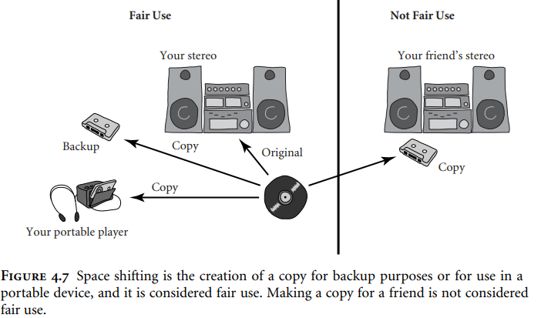

Slide 19
“Copyright Infringement” vs “Fair Use Doctrine”
Aspect | Copyright Infringement | Fair Use Doctrine
Definition | Unauthorized use of copyrighted material without permission, violating the owner’s rights. | Legal exception allowing limited use of copyrighted material without permission under specific conditions.
Purpose | Protects creators' exclusive rights to control and benefit from their work. | Balances copyright protection with public interest, enabling education, criticism, and innovation.
Legality | ❌ Illegal; may result in lawsuits, fines, or injunctions. | ✅ Legal when criteria are met; serves as a defense in infringement cases.
Permission Required | Required but not obtained. | Not required if use qualifies as fair.
Key Factors | - Extent of copying (substantial part) - Commercial impact on original work | 1. Purpose/character of use (e.g., educational, transformative) 2. Nature of copyrighted work 3. Amount used 4. Market effect
Common Examples | - Pirating software/movies - Republishing content without consent | - Quoting for review/criticism - Using excerpts in teaching/research
Result | Penalties: Damages, legal fees, cessation of use | No penalty; use is permitted and protected.
Nature | Offense against copyright holder | Defense against infringement claims

Slide 20
How to obtain intellectual property nationally & internationally ?

Slide 21
How to Obtain Intellectual Property Rights in Pakistan
The intellectual property ecosystem in Pakistan is governed by specific laws and administered by the Intellectual Property Organization of Pakistan (IPO-Pakistan).
Each type of IP has its own distinct registration process
Official Web: https://ipo.gov.pk

Slide 22
General Steps & Best Practices for All IP Registration
Identify Your IP: Determine what type of intellectual property you have (brand, invention, creative work).
Conduct a Search: Always conduct a thorough search (especially for trademarks and patents) to ensure your IP is novel and does not infringe on existing rights.
Prepare Documentation: Gather all necessary information, representations of the IP, and applicant details.

Slide 23
General Steps & Best Practices for All IP Registration
4. File the Application:
  Portal: The preferred method is via the IPO-Pakistan e-filing portal (https://ipo.gov.pk) for patent, trademarks and copyrights.
  Manual: Physical applications can be submitted at the respective offices in Karachi, Lahore, or Islamabad.
5. Pay Official Fees: Fees vary depending on the type of IP and the applicant's status (individual, small enterprise, large company).

Slide 24
General Steps & Best Practices for All IP Registration
6. Monitor & Respond: Track your application status online and respond promptly to any queries or objections from the IPO.
7. Enforce Your Rights: Once registered, it is the owner's responsibility to monitor the market and enforce their rights against infringement through legal channels.

Slide 25
How IP Protection Works Internationally ??
1. Since IP rights are territorial, to protect your invention, brand, or work in other countries, you must obtain separate IP rights in each of those countries where you want protection.
2. There is no such thing as a "global patent" or "worldwide trademark." However, international treaties have simplified the process for applying in

Slide 26
International Treaties on IPs
IP Type | Primary Int'l Treaty | How it Works | Is it a "Worldwide" Right?
Patent | Patent Cooperation Treaty (PCT) | File one int'l application to reserve rights, then must apply individually in each country. | No. Must secure rights country-by-country. (150 member countries)
Trademark | Madrid Protocol | File one application to seek protection in multiple member countries. | No. Protection is only in the countries you designate and approve it. (130 member countries)
Copyright | Berne Convention | Protection is automatic in all member countries upon creation. | Yes, automatically. But enforcement is strongest with local registration. (179 member countries)

Slide 27
Software cross-licensing Agreements

Slide 28
Software cross-licensing Agreements
Software Cross-Licensing Agreement is an arrangement where two or more companies give each other permission (licenses) to use their software, technologies, or patents.
This type of agreement helps companies avoid legal disputes, share innovations, and save development costs by using each other’s intellectual property legally.
In simple words: Software cross-licensing means “you can use my software or technology if I can use yours.”

Slide 29
Example
Example 1:
Microsoft and Samsung have a cross-licensing agreement that allows both to use each other’s patented technologies in their software and devices.
Example 2:
Google and Apple may cross-license certain software technologies to make apps compatible across their platforms.

Slide 30
Defensive Publishing

Slide 31
Defensive Publishing
Defensive Publishing is the act of publicly disclosing an invention to prevent others from patenting it, while allowing everyone to use it freely.
Purpose:
To protect an idea from being patented by others.
To keep technology open for public use.
To avoid legal battles over ownership.

Slide 32
Example
A software company invents a small improvement in code but doesn’t want to file a patent. So, it publishes the code online or in a journal, making it public knowledge.
→ Now no one else can patent that same idea.

Slide 33
Submarine Patents

Slide 34
Submarine patent
Submarine Patent is a patent that stays hidden for years after filing and later “surfaces” to claim rights or royalties once others start using the same technology.
Why it’s called “Submarine”: Because it stays underwater (hidden) for years and then suddenly surfaces to attack others with legal claims — just like a submarine.

Slide 35
Example
An inventor files a patent for a computer networking method but delays its approval process for many years. When the technology becomes common in the industry, the patent is approved — and the inventor demands money from companies using that method.
→ This is a submarine patent.

Slide 36
Example
An inventor or company may be able to predict the future direction of a particular technology, or the activities of their competitors. In doing so, a patent application could be filed in the US which is not allowed to proceed to grant, but rather is kept pending. Because there was no pre-grant publication of patent applications in the US before 2000, a third party may then develop a product, which is covered by the scope of the submarine patent, unaware of the pending application. Once the product is on the market, the patent application can then be allowed to proceed to grant. The patentee can then demand a royalty from the unsuspecting third party.

Slide 37
Example
For example, under the old system, someone in 1950 could have filed a patent on, say, a packet-based computer network router, though there were as yet hardly any computers to speak of. By requesting repeated "continuations" during the patent application process, the filer could force the patent to be delayed indefinitely until packet-based routers started to come onto the market, say in 1970. The filer then stops requesting continuations, the patent issues, and the patent-seeker can collect royalties on network routers for 17 years from that point, until 1987

Slide 38
Patent Farming/troll

Slide 39
Patent Farming/troll
Patent Farming (Patent Trolling) is when a person or company earns money by suing others for patent infringement instead of using the patent to produce or innovate.
The entity engaged in this practice is typically called a Patent Assertion Entity (PAE), or a "Patent Troll.“
Example:
A company buys a patent for a simple smartphone feature (like swipe to unlock) but doesn’t make phones.
Later, it sues phone manufacturers like Samsung or Apple for using that feature — just to get a financial settlement.
→ This is patent trolling or patent farming.

Slide 40
Patent Troll , How It Works
Acquisition: The PAE acquires patents. This can be done through:
  Internal R&D: (Less common) Funding small teams to invent and file patents specifically for the portfolio.
  Purchase: Buying patents from bankrupt companies, individual inventors, or large corporations that no longer see value in them. These are often patents for older, foundational technologies.
  Filing: Prolific filing of patents on very broad or incremental ideas.
Aggregation: The PAE builds a large, dense portfolio of patents, often related to a specific technology area (e.g., Wi-Fi, image compression, smartphone features).
Monitoring & Analysis: The PAE monitors the market for companies that are successfully using technology that may potentially infringe on one or more patents in their portfolio.
Monetization (The "Harvest"): This is the core of the business model. The PAE approaches the target company and demands payment

Slide 41
Trade Secrets

Slide 42
Trade Secrets
Trade Secret is confidential business information, such as a formula, process, or strategy, that gives a company a competitive advantage and is protected by keeping it secret.
Examples:
The Coca-Cola formula (exact recipe of the drink).
Google’s search algorithm.
KFC’s blend of 11 herbs and spices.
A company’s customer list or marketing strategy.

Slide 43
Employees and Trade Secrets
Employees are the greatest threat to trade secrets
Unauthorized use of an employer’s customer list
  Customer list is not automatically considered a trade secret
  Educate workers about the confidentiality of lists
  Court must consider:
  did the firm take steps to keep the list secret?
  did the firm expend money or effort to develop the customer list?

Slide 44
Non-disclosure Agreement (NDA)
Nondisclosure clauses in employee’s contract
  The employees cannot take copies of software programs
  The employees cannot reveal details of software owned by the organization.
Enforcement can be difficult
Confidentiality issues are reviewed at the exit interview

Slide 45
Non-compete agreements
Protect intellectual property from being used by competitors when key employees leave
Require employees not to work for competitors for a period of time
Example:
  The employee agrees as a condition of employment that in the event of termination for any reason, he or she will not engage in a similar or competitive business for a period of two years, nor will he or she contact or solicit any customer with whom Employer conducted business during his or her employment. This restrictive covenant shall be for a term of two years from termination, and shall encompass the geographic area within a 100-mile radius of Employer’s place of business.

Slide 46
Can a Product or Service Have Multiple Forms of IP?
Yes.
For example, a mobile phone might use technology (data encryption) and include features (a camera) that have been patented. The phone may be marketed under a brand name that has a registered trademark. The look and feel of the phone’s home screen design may be the subject of a copyright registration. If the phone’s manufacturer hasn’t created all of the phone’s IP by itself, it may have licensed some of the IP from others.

Slide 47
Key Intellectual Property Issues

Slide 48
Key Intellectual Property Issues
Issues that apply to intellectual property and information technology
  Plagiarism
  Reverse engineering
  Open-source code
  Competitive intelligence
  Trademark infringement
  Cybersquatting

Slide 49
Plagiarism
Plagiarism means using someone else’s words, ideas, or work without giving proper credit — and pretending it’s your own.
Examples:
Copying a paragraph from Wikipedia into your assignment without mentioning the source.
Using another student’s project and submitting it as yours.
Taking ideas from a research paper but not citing the author.

Slide 50
Plagiarism forms
Verbatim copying: copying text or content word-for-word from another source without proper acknowledgment or quotation, which is a form of plagiarism. Example: Copying code from an online source without crediting the author.
Self-plagiarism: Self-plagiarism is the act of reusing one’s own previous work or writing and submitting it as new without proper acknowledgment or permission. Example: Submitting the same assignment in two different courses.

Slide 51
Difference
Type | Meaning | Whose Work is Copied | Example
Plagiarism | Using someone else’s ideas, words, or work without giving credit. | Someone else’s work | Copying a paragraph from a website into your assignment without citation.
Verbatim Copying | Copying text word-for-word (exact same words) without quotation or credit. | Someone else’s work | Copy-pasting a whole paragraph from a book exactly as it is.
Self-Plagiarism | Reusing your own previously submitted work without permission or citation. | Your own past work | Submitting the same essay in two different courses.

Slide 52
HEC Plagiarism policy for academic:
What is Plagiarism? (HEC Definition)
  "The act of using or closely imitating the language, ideas, and thoughts of another author without authorization and representing it as one's own original work."
This includes:
  Copying text without quotation marks & citation.
  Paraphrasing ideas without acknowledgment.
  Submitting someone else's work as your own.
Reusing your own previous work without disclosure (Self-Plagiarism).
For CS: Copying code without proper attribution.
Source: http://hec.gov.pk/english/services/faculty/Documents/Plagiarism/Plagiarism%20Policy.pdf

Slide 53
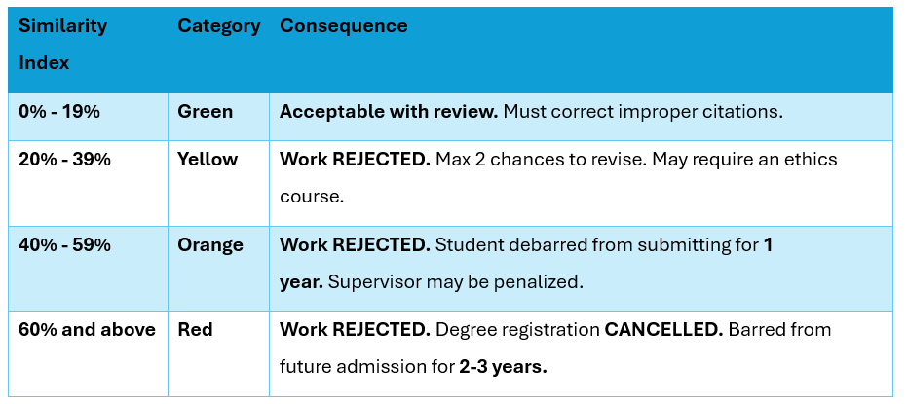
HEC Plagiarism policy for academic:
The Similarity Index & Categories
  HEC uses plagiarism detection software (e.g., Turnitin) to generate a Similarity Index (% of matched text).

Slide 54
Implications for Computer Science Students
The HEC policy covers all academic work, which includes software code and technical projects.
Code Plagiarism is a Major Offense: Copying code from GitHub, Stack Overflow, or another student without proper attribution is considered plagiarism under this policy. This applies to assignments, projects, and thesis work.
How to Avoid It:
  Cite Your Sources: If you use code from an online source, clearly comment in your code to provide the URL and author.
  Use Quotation Marks for Code: For direct copying, use comments to "quote" the code and provide the source.
  Write Your Own Algorithms: Understand an algorithm and then implement it in your own style and logic, rather than copying it line-by-line.
  Use Approved Collaboration: Work with classmates only if the project is designated as a group project. Otherwise, your work must be your own.

Slide 55
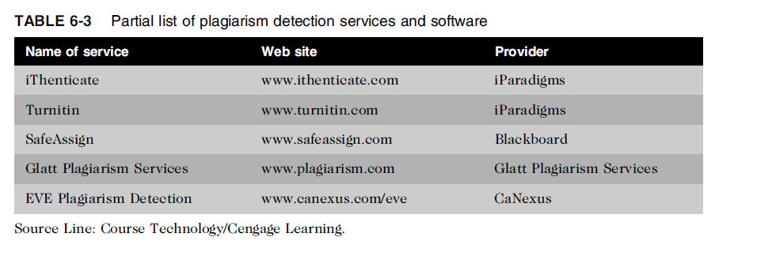
Plagiarism Detection Tools

Slide 56
Reverse Engineering
Process of taking something apart in order to:
  Understand it
  Build a copy of it
  Improve it
Applied to computer:
  Hardware
  Software
Convert a program code
  To a higher-level design
  To create a new representation
Begins by extracting design stage details

Slide 57
Reverse Engineering (cont’d.)
Convert an application that ran on one vendor’s database to run on another’s
Compiler
  Language translator
  Converts computer program statements expressed in a source language to machine language
Software manufacturer
  Provides software in machine language form
Decompile
  Reads machine language
  Produces source code

Slide 58
Reverse Engineering (cont’d.)
Courts have ruled in favor of reverse engineering:
  To enable interoperability
Software license agreements forbid reverse engineering
Ethics of using reverse engineering are debated
  Fair use if it provides useful function/interoperability
  Can uncover designs that someone else has developed at great cost and taken care to protect

Slide 59
Open-Source Code
Program source code made available for use or modification:
  As users or other developers see fit
Basic premise
  Many programmers can help software improve
  Can be adapted to meet new needs
  Bugs rapidly identified and fixed
  High reliability

Slide 60
Reasons to Create Open Source
To earn respect for solving a common problem
Feel the need to pay back
To attract potential clients
Reluctant to license and market it

Slide 61
Competitive Intelligence
Competitive Intelligence is the legal and ethical collection of information about competitors and market conditions to help a company make strategic business decisions.
Examples:
A company studies a competitor’s new product features to improve its own design.
A business analyzes market reports, advertisements, and websites to learn about competitors’ pricing or strategies.
A marketing team tracks customer reviews of rival brands to find weaknesses.

Slide 62
Trademark Infringement
Trademark Infringement is the unauthorized use of a registered brand name, logo, or symbol that can cause confusion about the true source of goods or services.
Examples:
Selling shoes using a logo similar to Nike’s “✓” symbol.
Opening a restaurant called “McRonald’s” with a logo like McDonald’s.
Printing Apple’s logo on phones not made by Apple.

Slide 63
Cybersquatting
Cyber squatters
  Cybersquatting is the act of registering or using a domain name similar to a trademark or brand to profit from the legitimate owner’s reputation.
Internet Corporation for Assigned Names and Numbers (ICANN)
  Several top-level domains (.com, .edu, edu., .gov, .int, .mil, .net, .org, aero, .biz, .coop, .info, .museum, .name, .pro, .asis, .cat, .mobi, .tel, and .travel)
Anti-cybersquatting Consumer Protection Act allows trademark owners to challenge foreign cyber squatters

Slide 64
Scenario:
You are a software engineer working at TechNova Solutions, a company that recently developed a new educational app called SmartLearn. The app uses an AI-based algorithm to personalize learning for each student. The algorithm and the app design were developed entirely by your team over several months.
A few weeks after launch, you discover that another company, EduPro, has released a very similar app that:
- Uses an almost identical algorithm (which they claim to have developed independently).
- Has copied parts of SmartLearn’s user interface and code structure.
- Registered the domain name smartlearnpro.com to attract users searching for your app.
- Claims that their usage of your educational materials (videos, notes, etc.) falls under 'Fair Use.'
Now, your company is preparing to take legal action.

Slide 65
Questions
What type of Intellectual Property (IP) is most relevant in this case? Explain briefly.
How can Software Copyright Protection help TechNova protect SmartLearn?
Would the Fair Use Doctrine apply to EduPro’s use of SmartLearn’s educational content? Why or why not?
Can TechNova file for a Patent or Software Patent for their AI algorithm? What conditions must be met?
How can TechNova protect its algorithm as a Trade Secret instead of patenting it?
Identify two Key Intellectual Property issues raised in this scenario.
If a developer at EduPro copied code from SmartLearn without giving credit, what form of Plagiarism is this?
EduPro claims they “studied” SmartLearn’s app to build their own. Does this count as Reverse Engineering? Is it legal?
By registering smartlearnpro.com, what kind of IP violation might EduPro be committing? (Hint: It relates to domain names.)
Suggest one preventive measure TechNova can take to avoid such IP disputes in the future

Slide 66
Lecture Summary
Intellectual property is protected by laws for:
  Copyrights
  Patents
  Trademarks
  Trade secrets
Plagiarism is stealing and passing off the ideas and words of another as one’s own
Reverse engineering
  Process of breaking something down in order to understand, build a copy of, or improve it
Open source code
  Made available for use or modification as users or other developers see fit
Competitive intelligence
  Uses legal means and public information
Trademark infringement
  Use of other’s trademark in a Web site can lead to issues
Cybersquatting
  Registration of a domain name by an unaffiliated party

